Slide 1
Overview slides
1 April 2025

Slide 2


Datasets
Hosted portals
112,514
53
Country Participants
65
Peer-review papers
using data
12,636
Organizational Participants
Average records
downloaded per month (2025)
42
267.6 billion
Species
occurrence records
Publishers
2,427
3,089,709,484
By the numbers | 1 April 2025
www.gbif.org

Slide 3
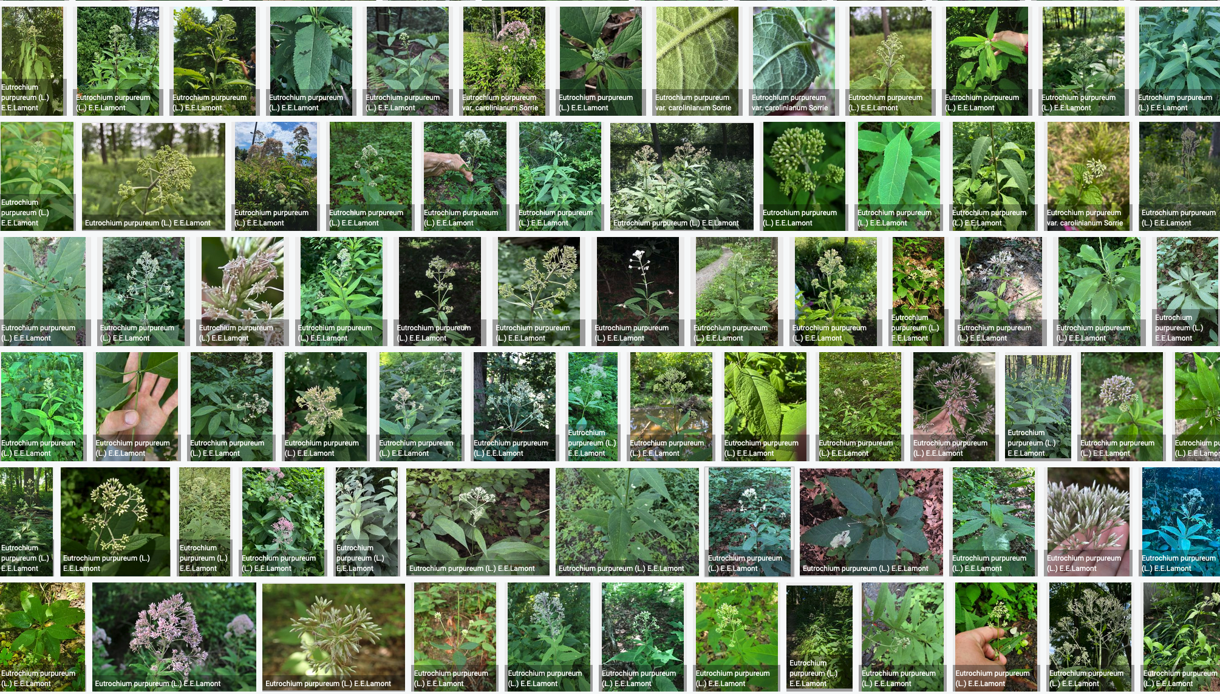
Species occurrence records with multimedia evidence
1 April 2025
223.0 million records with taxonomically identified images
145.6 million human observations
67.7 million specimens
7.1 million material samples
1.5 million fossil specimens
1,584,207 audio files
4,940 videos
https://www.gbif.org/occurrence/gallery

Slide 4
GBIF Participant countries
1 April 2025
Voting Participants
Associate Participants

Slide 5
GBIF network of data publishing institutions
1 April 2025
146
countries/areas with institutions
sharing data through GBIF
Number of active publishers by country or area

Slide 6
GBIF.org traffic by country: 2025
1 April 2025
Rank | Country/Territory | Visitors | Visits | Effective visits* | % Effective visits | 2024 rank | Pages / visit
1 | United States | 215,497 | 215,555 | 94,844 | 7.94 % | 1 | 4.51
2 | Colombia | 99,890 | 125,577 | 59,021 | 4.94 % | 2 | 4.55
3 | Spain | 89,135 | 113,158 | 58,842 | 4.93 % | 4 | 5.84
4 | Brazil | 113,326 | 132,332 | 58,226 | 4.88 % | 8 | 3.96
5 | China | 110,216 | 174,848 | 55,951 | 4.69 % | 7 | 4.97
6 | France | 100,855 | 125,761 | 55,335 | 4.63 % | 5 | 4.95
7 | Germany | 79,135 | 102,048 | 50,004 | 4.19 % | 9 | 6.01
8 | Indonesia | 70,903 | 87,939 | 48,366 | 4.05 % | 3 | 5.59
9 | Mexico | 87,519 | 102,606 | 46,173 | 3.87 % | 6 | 4.39
10 | India | 90,897 | 101,677 | 40,671 | 3.41 % | 10 | 4.00
 | TOTAL | 2,059,858 | 2,595,374 | 1,193,872 | 100.00% |  | 4.94

Slide 7
Occurrences published by country: 2025
1 April 2025
Rank | Country/Territory | 2025 | 2025 total | 2024 rank
1 | United Kingdom | 20,063,559 | 12,938,043 | 7
2 | France | 8,721,082 | 43,910,491 | 2
3 | United States | 7,752,632 | 158,323,610 | 1
4 | Netherlands | 5,951,583 | 25,251,786 | 4
5 | Sweden | 5,299,922 | 25,696,307 | 3
6 | Switzerland | 2,649,930 | 3,062,243 | 21
7 | Denmark | 1,464,207 | 3,440,172 | 18
8 | Germany | 1,454,093 | 3,012,733 | 22
9 | Israel | 1,433,554 | 1,009,227 | 35
10 | Norway | 1,060,436 | 4,061,537 | 17
OTHER COUNTRIES + AREAS | OTHER COUNTRIES + AREAS | 6,298,805 | 97,322,395
TOTAL |  | 62,149,830 | 428,451,251

Slide 8
Data download requests by country: 2025
1 April 2025
Rank | Country |  | 2025 | 2024 total | 2024 rank
1 | China | 23,836 |  | 63,485 | 1
2 | United States | 22,608 |  | 41,921 | 2
3 | Mexico | 11,839 |  | 29,712 | 3
4 | United Kingdom | 6,754 |  | 13,502 | 7
5 | Colombia | 6,065 |  | 21,274 | 5
6 | Spain | 5,510 |  | 14,704 | 6
7 | Brazil | 5,371 |  | 21,641 | 4
8 | Japan | 4,146 |  | 4,244 | 20
9 | Italy | 3,900 |  | 5,344 | 13
10 | Germany | 3,749 |  | 8,558 | 10
OTHER COUNTRIES + AREAS | ALL OTHERS | 42,136 |  | 115,002
TOTAL |  | 135,914 |  | 347,717
139
countries, islands & territories where users have ≥5 requested downloads in 2025
Notes:
DOWNLOADS NOT YET ADJUSTED FOR USERS ≥500 DOWNLOADS FOR JAN-MAR 2025

Slide 9
Peer-reviewed publications using GBIF-mediated data
1 April 2025

Slide 10
Data use in peer-reviewed journals: 2025
1 April 2025
Peer-reviewed uses by country
Peer-reviewed uses by region
End of Year |  |  | 2025 total | 2024 total | 2024 rank
1 | China |  | 187 | 529 | 1
2 | United States |  | 134 | 486 | 2
3 | United Kingdom |  | 52 | 186 | 5
4 | Brazil |  | 48 | 238 | 3
5 | Germany |  | 43 | 186 | 6
6 | Spain |  | 37 | 171 | 7
6 | Mexico |  | 37 | 186 | 4
8 | Australia |  | 31 | 104 | 10
9 | Italy |  | 28 | 107 | 8
10 | India |  | 27 | 78 | 12

Slide 11


Suggestions reviewed
Institutions
8,729
2,348
vv
Countries
Collections
123
9,937
Country editors
Digitized specimens
64
246,164,020
GRSciColl by the numbers | 3 April 2025
scientific-collections.gbif.org
Notes:
Our community of editors is doing a huge work to update GRSciColl. In 2024 alone, more than 1600 entries were added to GRSciColl. At the core of the GRSciColl work are our Nodes and the GBIF Regional support teams which have been working on reaching out to institutions in GRSciColl as an entry point to sharing GBIF data.

Slide 12




Hosted portals update
13
GBIF national Participants and regions
8
Institutional
53
Hosted portals in production
5
27
Networks/thematic networks
Scientific journal

Slide 14
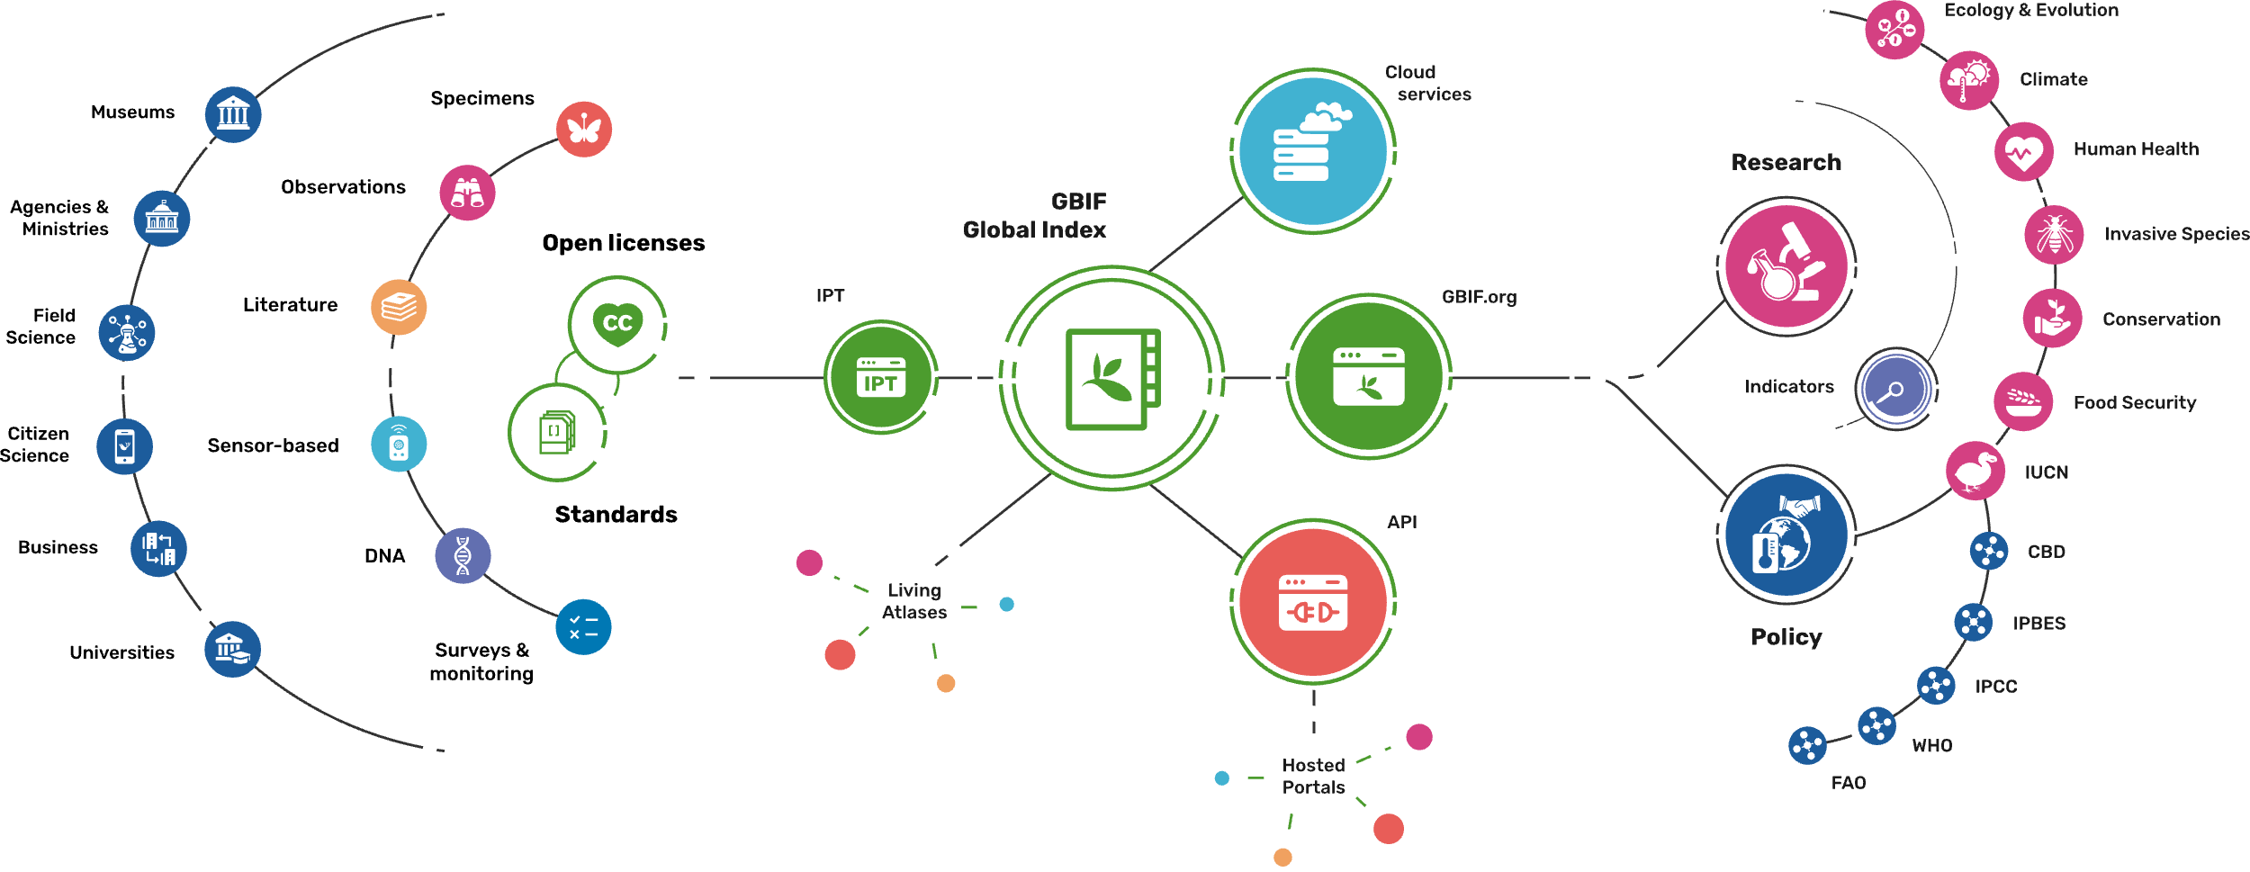
Providing biodiversity evidence for research and policy

Slide 15
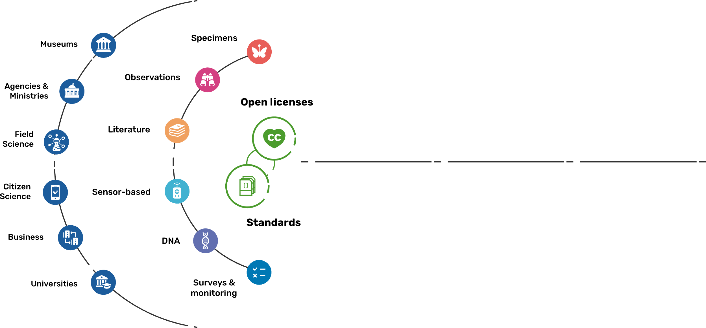
Sources of biodiversity evidence
Create
Combine sources of evidence

Slide 16
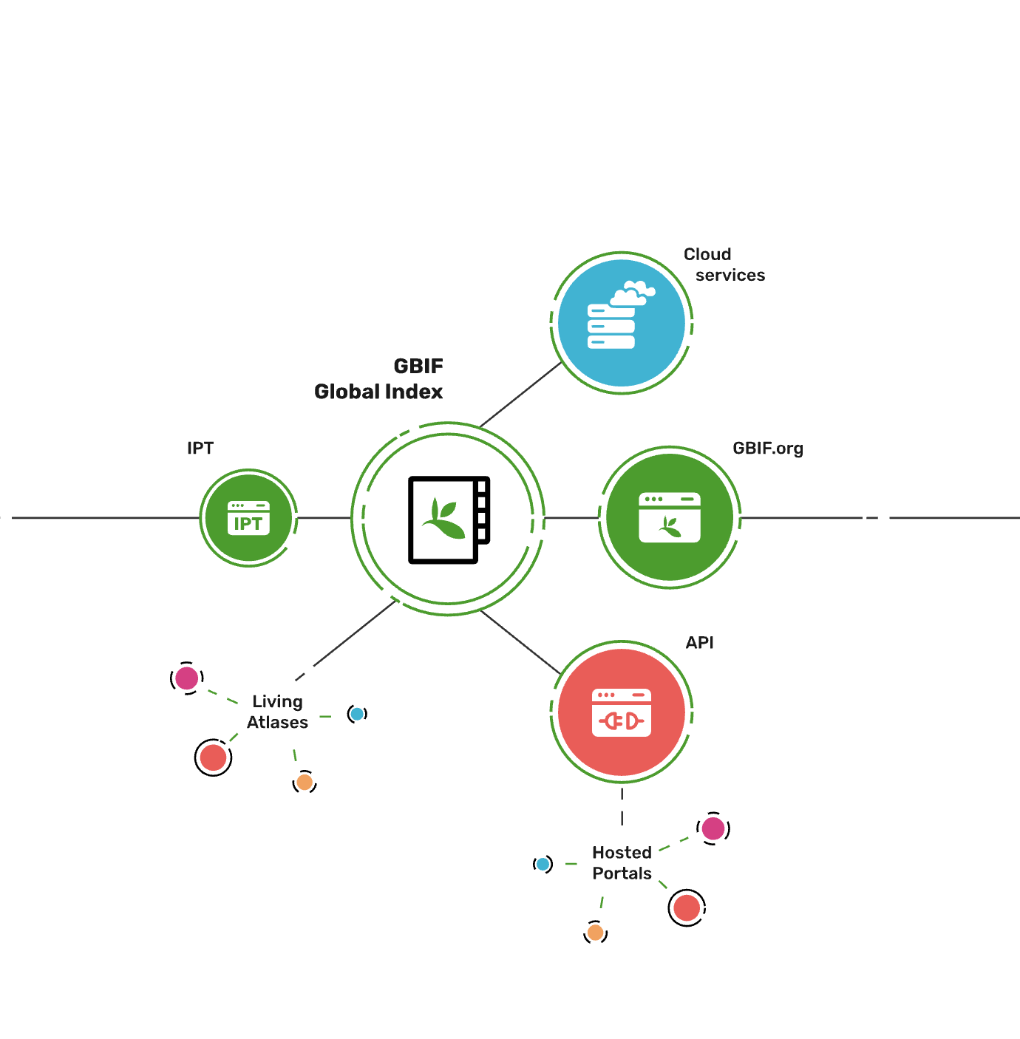
Access to biodiversity evidence
Share
FAIR and open access

Slide 17
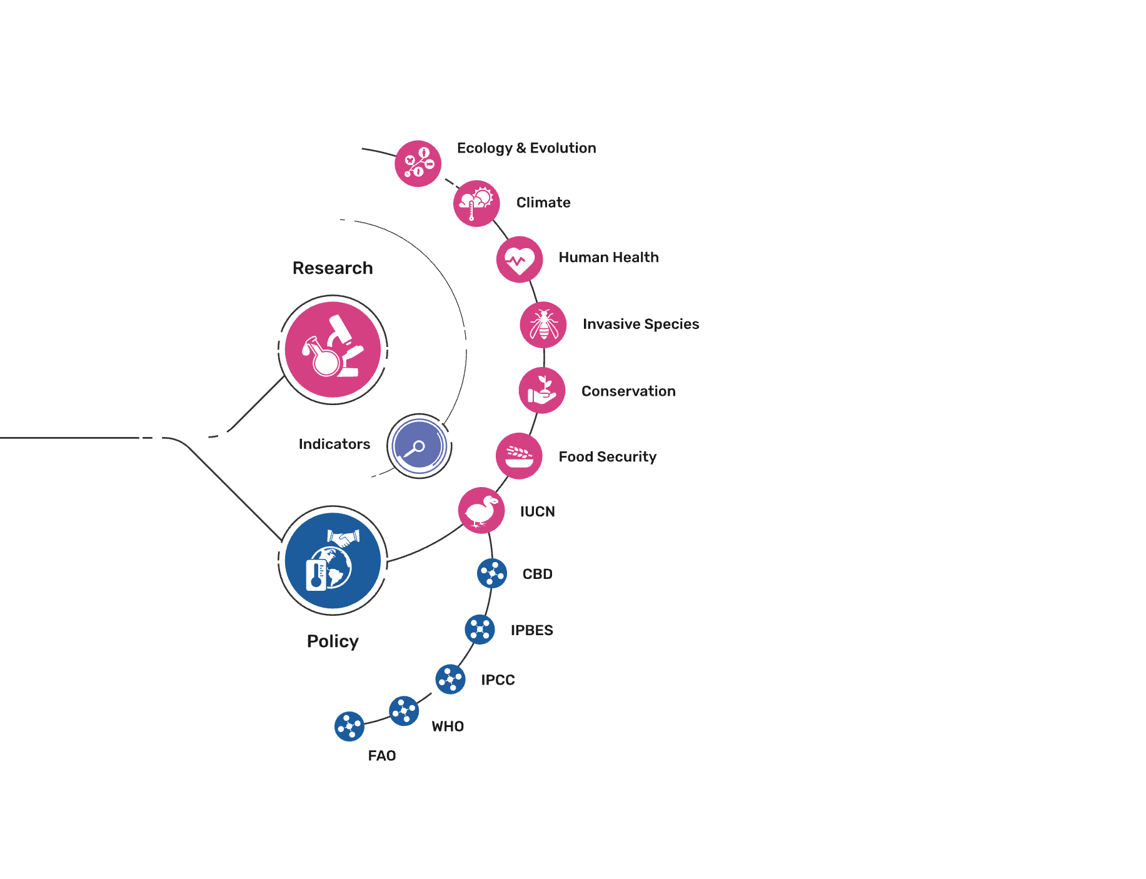
Uses of biodiversity evidence
Transform
Apply and use data

